Slide 1
Systematic & Scoping Reviews
March 28, 2023
Tim Rodgers & Amanda Giang

Slide 2
Overview
Types of Reviews
Steps in a Systematic Review
Research Question
Identify Articles
Screen Articles
Extract Data
Chart/Report Results

Slide 3
Background: types of reviews
Traditional narrative literature review
Systematic review
Scoping review
Other (won’t be our focus)
Evidence map – a visual representation of studies
Realist review – how and why complex social interventions work
Moher, D., Stewart, L., & Shekelle, P. (2015). All in the Family: systematic reviews, rapid reviews, scoping reviews, realist reviews, and more. Systematic Reviews, 4(183). https://doi.org/10.1186/s13643-015-0163-7
Notes:
Systematic review – formal methods – specific research question around intervention
Scoping review – overview of broad field – does not necessarily include data quality

Slide 4
Narrative review definition
A narrative or traditional literature review is a type of review that is typically conducted by an expert. This type of review doesn’t use any systematic methodology for finding the articles discussed – typically, the author uses their own experience to draw what they believe are the most important or relevant studies for the topic at hand
Pros – can be easier to read & to conduct, can give a clear picture of the current state of a field, allow for positionality
Cons – By nature somewhat biased – no attempt is made to search all literature. Cannot provide answers to quantitative questions in a systematic way.
Examples – Critical Review, Perspective, Literature Review, etc.

Slide 5
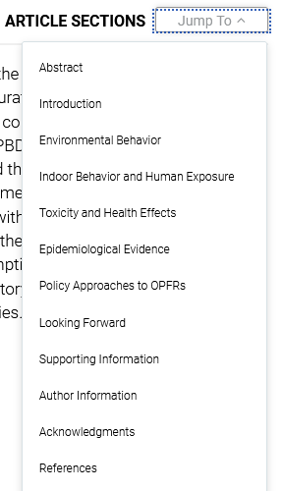
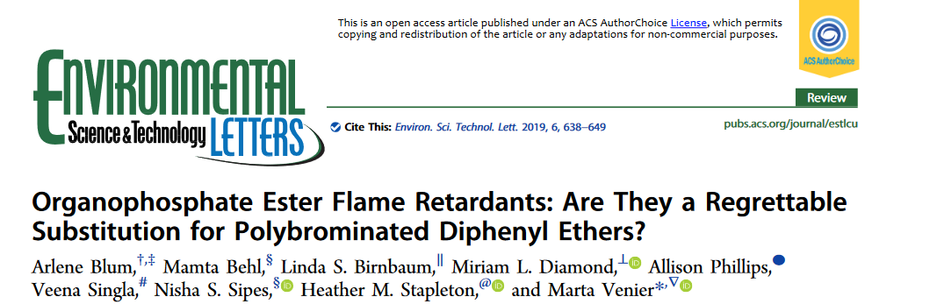
Narrative review Example
No methods – no systematic methodology applied
Big topic, maybe no
“objective” answer
Bunch of big names

Slide 6
Systematic review definition
"A systematic review attempts to identify, appraise and synthesize all the empirical evidence that meets pre-specified eligibility criteria to answer a given research question. Researchers conducting Systematic Reviews use explicit methods aimed at minimizing bias, in order to produce more reliable findings that can be used to inform decision making.”
Pros – Can provide quantitative answers to systematic questions.
Cons – Can be a lot of work! Narrow topic sometimes means narrow relevance.
Cochrane Handbook for Systematic Reviews of Interventions: handbook.cochrane.org

Slide 7
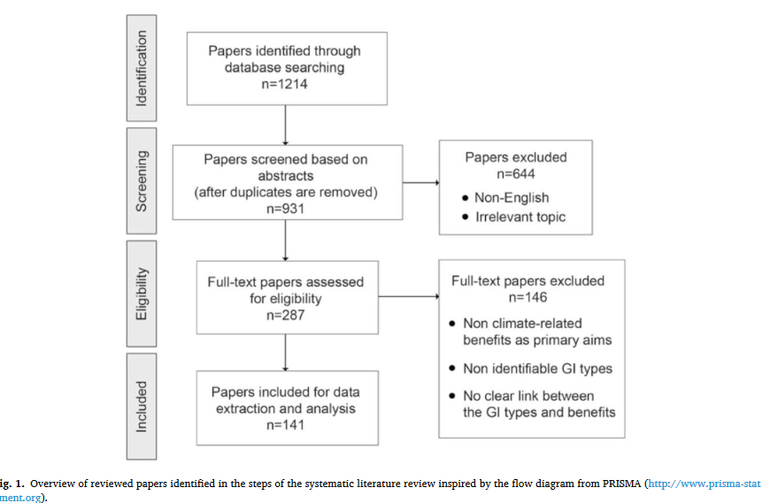

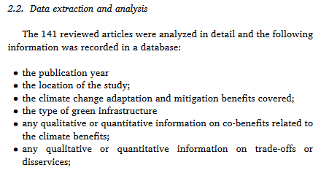
Systematic review definition
Systematic methodology
Deeper data extraction
Narrower topic with
definitive answer

Slide 8
Scoping review definition
A scoping review or scoping study is a form of knowledge synthesis that addresses an exploratory research question aimed at mapping key concepts, types of evidence, and gaps in research related to a defined area or field by systematically searching, selecting, and synthesizing existing knowledge
Pros – provides a systematic overview of a field of study. Can answer broader question than systematic review. Can set-up a systematic review on a narrower topic
Cons – Can be a lot of work! Sometimes these types of reviews have trouble getting to the point
Colquhoun, H. L., Levac, D., O’Brien, K. K., Straus, S., Tricco, A. C., Perrier, L., … Moher, D. (2014). Scoping reviews: time for clarity in definition, methods, and reporting. Journal of Clinical Epidemiology, 67(12), 1291–1294. https://doi.org/10.1016/J.JCLINEPI.2014.03.013

Slide 9
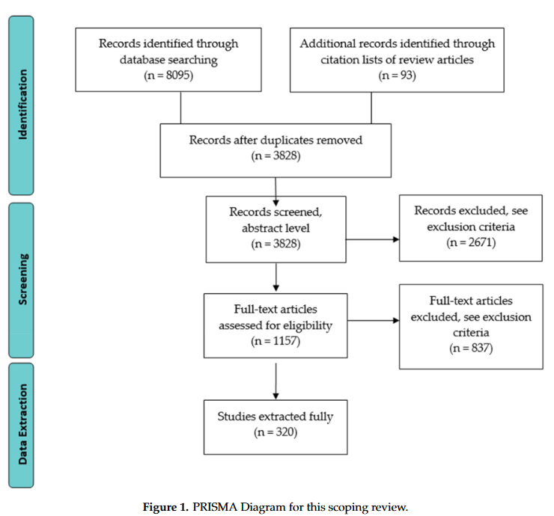

Scoping review Example
Overview of field
Bunch of nobodies
(plus their Pis)
Follows explicit &
systematic methodology

Slide 10
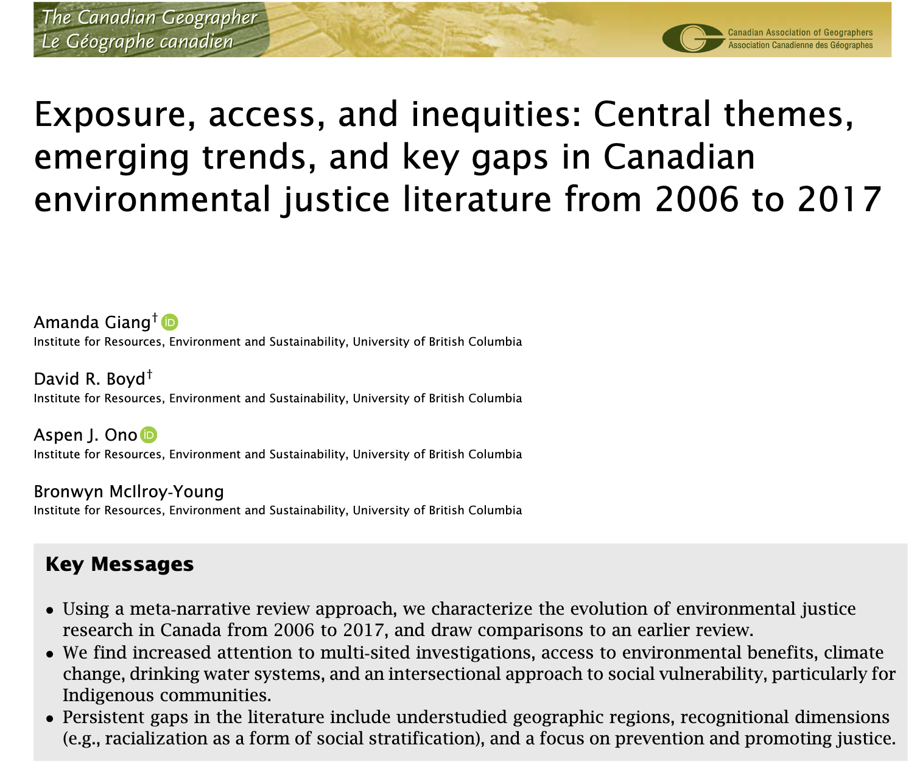
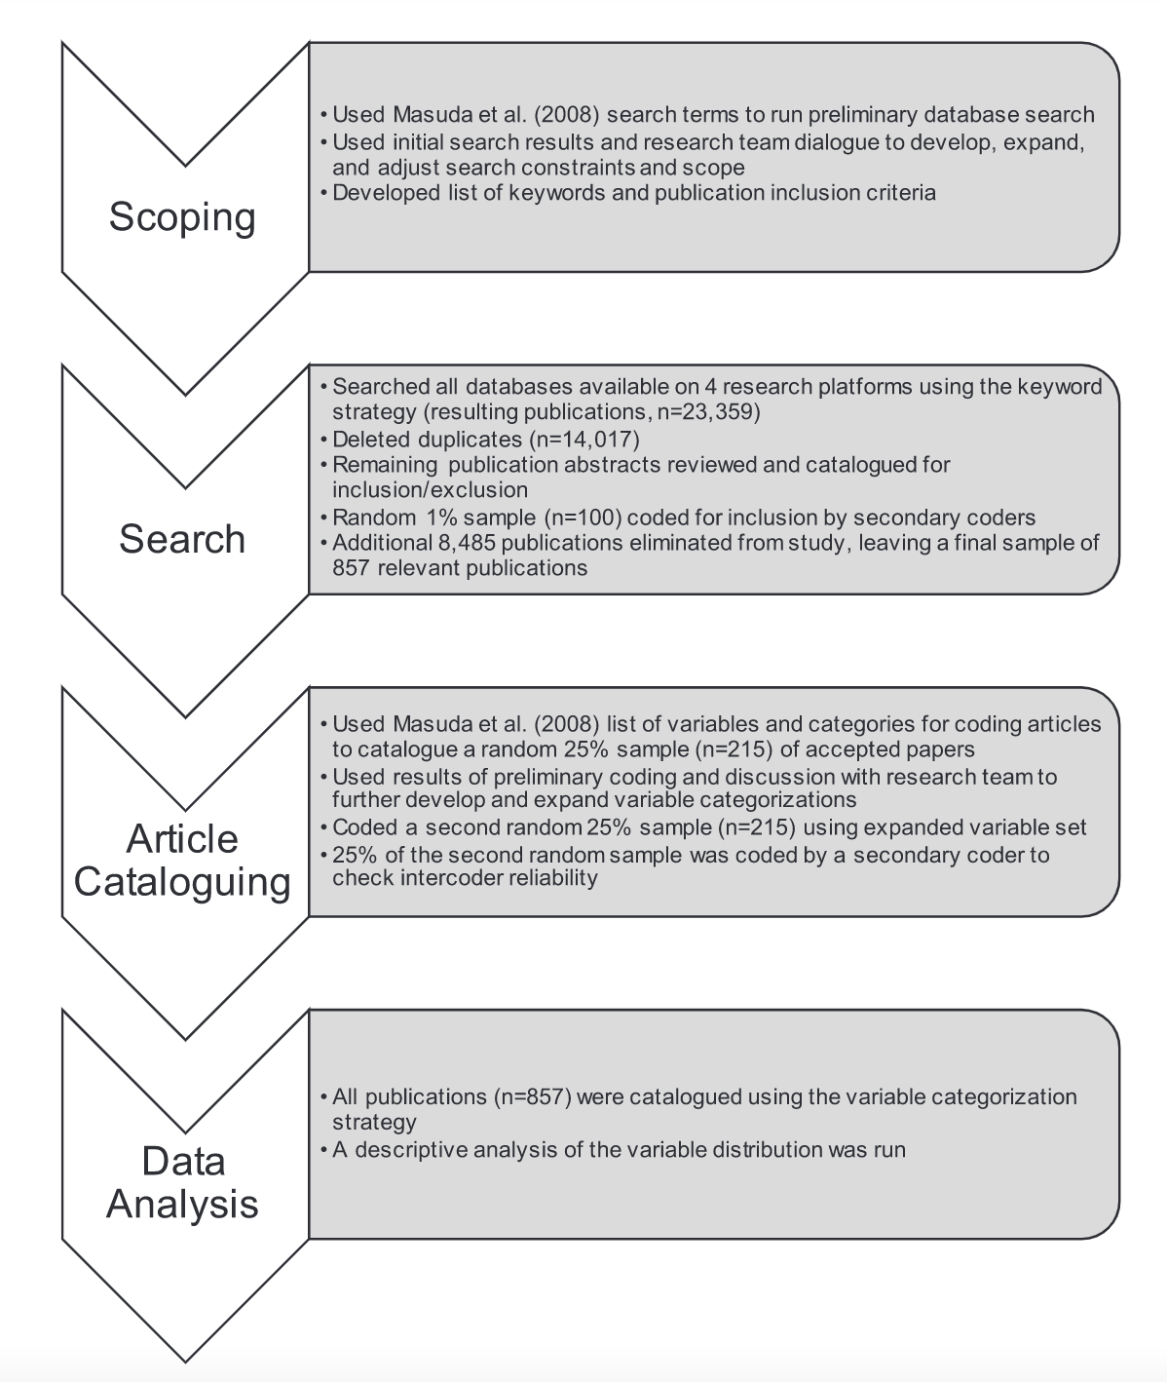
Scoping review Example

Slide 11
Systematic or Scoping Review Methodology
After planning, can consider registering the protocol! More common in medicine, psychology, but increasing in environmental science as well.
Stage 1
Identify the Research Question
Stage 2
Identify Relevant Studies
Stage 6
Stage 5
Stage 4
Stage 3
Screen & Select Studies
Extract and Synthesize Data
Chart the Data & Report Findings
Consultation (optional)
Adapted from: Arksey, H., & O’Malley, L. (2005). Scoping studies: towards a methodological framework. Journal of Social Research Methodology, 8(1), 1364–5579. https://doi.org/10.1080/1364557032000119616

Slide 12
Stage 1: Identify the Research Question
This is really hard! Too broad = impossible, too narrow = not useful
Useful to iterate while you develop search criteria
Example: Bioretention scoping review (Spraakman & Rodgers et al.,2020):
How is performance of bioretention being assessed in the literature?
How do we define performance of bioretention?
What types of criteria and metrics are used to assess water quality and quantity field performance of bioretention?
What are the theoretical underpinnings of model performance of bioretention?
How is bioretention performing, according to the defined criteria and metrics?

Slide 13
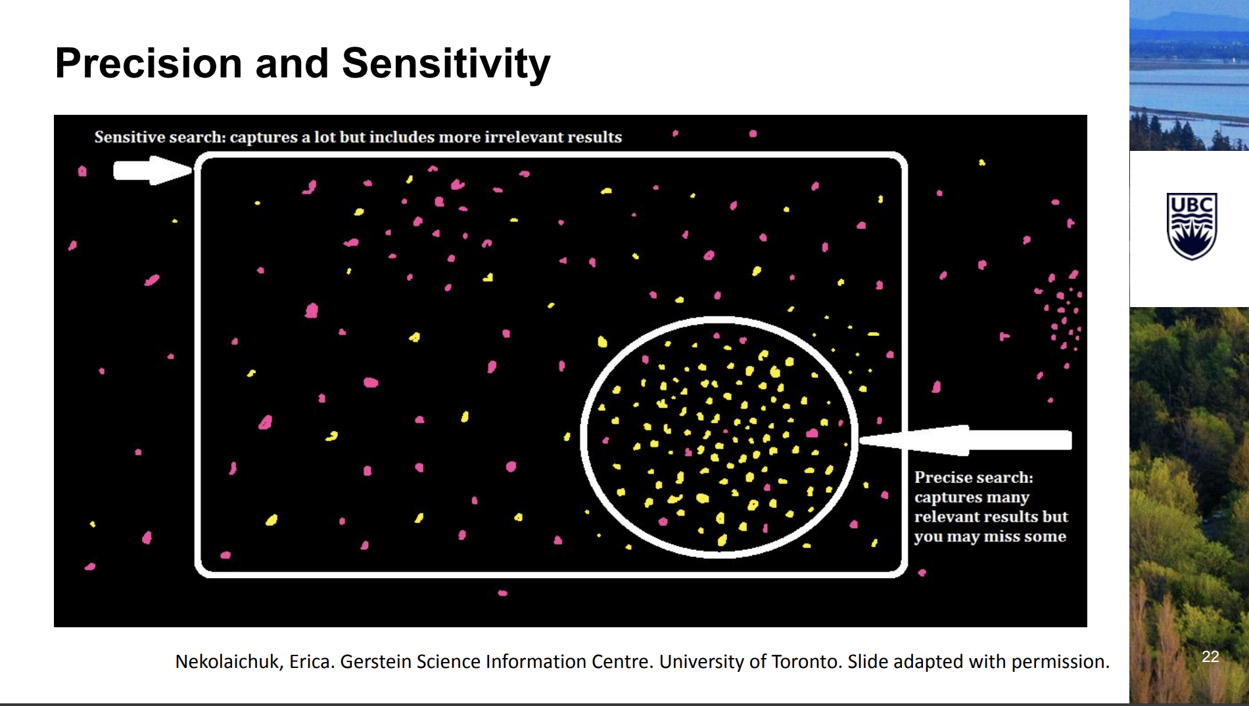
Stage 2: Identify Relevant Studies
Need to develop a search term – has to include ALL relevant studies!
Test vs papers you know should be in there, see if it captures previous or related review article references
Iterate with research question
Decide what databases to search
Example: Bioretention Scoping Review
(bioretention OR biofiltration OR bioinfiltration OR biofilter OR "rain garden" OR bioswale) AND (storms OR water quality OR storm sewer* OR rain OR infiltrat* OR hydrolog* OR runoff OR “water balance”)
Databases: Engineering village, web of science (CORE, BIOSIS), SCOPUS, EBSCO, JSTOR, etc
UBC Library Systematic and Scoping Review Workshop Series

Slide 14
Stage 2: Identify Relevant Studies
Database | Number of Results Obtained —October 2018 | Number of Results Obtained —4 April 2020
Engineering Village | 2733 | 3643
Web of Science—Core Collection | 1412 | 1657
Web of Science—BIOSIS Citation Index | 703 | 843
Web of Science—BIOSIS Previews | 700 | 840
Web of Science—SciELO | 17 | 24
Scopus | 988 | 1228
EBSCO | 263 | 297
ProQuest—Avery Index to Architectural Periodicals | 8 | 8
ProQuest—Dissertations and Theses Globalª | 381 | 0*
JSTOR^{b} | 43 | 15
SciFinder | 386 | 0

Slide 15
Stage 3: Screen & Select Studies
Studies typically screened twice – best-practice is 2 reviewers at each stage!
Title-abstract screen
Full-text screen
Need to develop inclusion and exclusion criteria (this may again be somewhat iterative)
Inter-rater reliability: Measure of agreement between two or more assessors who rate/code/assess the same thing – can be assessed quantitatively (e.g., Cohen’s Kappa)
If there is disagreement? Discuss and refine criteria.

Slide 16
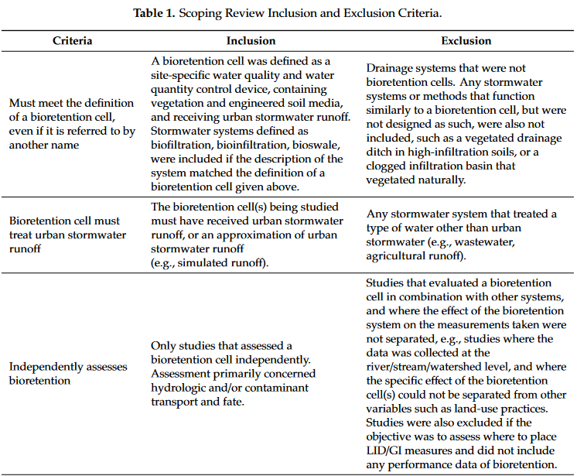
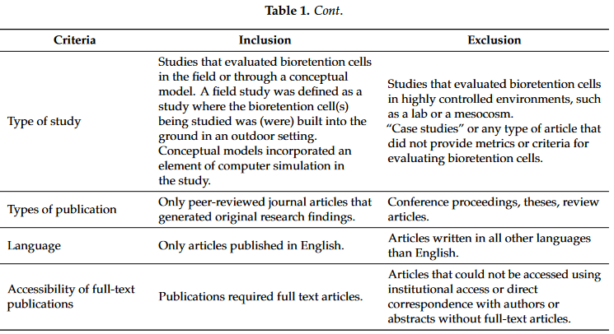
Stage 3: Screen & Select Studies (example)

Slide 17
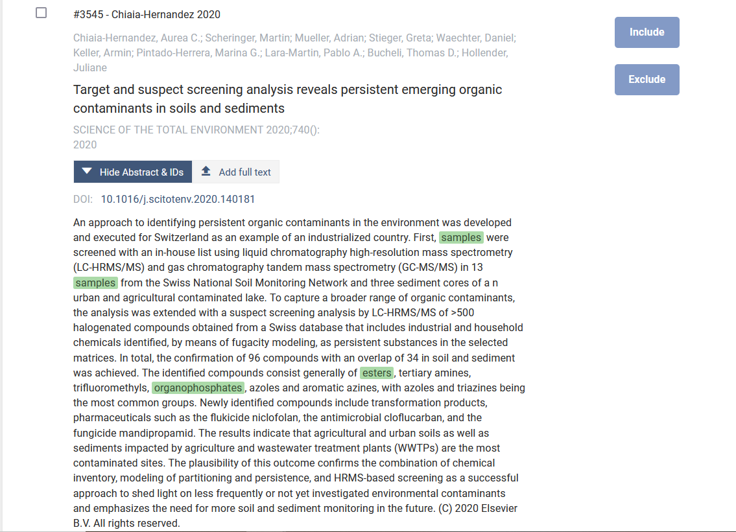
Stage 3: Screen & Select Studies (tools)
Tools for screening help:
Split the data between reviewers
Highlight keywords
Include/exclude reasons
De-duplication
E.g.
COVIDENCE (at right)
RAYYAN

Slide 18
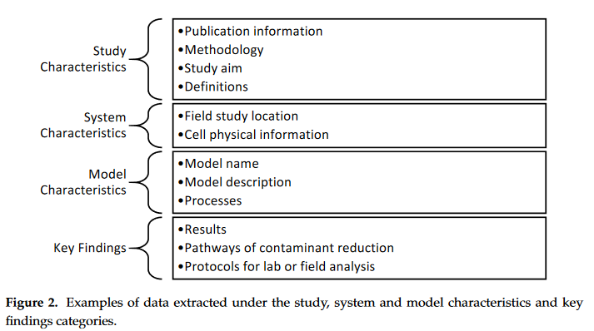
Stage 4: Extract and Synthesize Data
Decide what data you want to extract – bibliometric info, quantitative info, qualitative info
Systematic review – typically this will be the target of the review e.g. “XX cancer drug had YY effect”
Scoping review – can be more nebulous. Don’t make it too broad or you will regret it!
Example (BC Scoping review)

Slide 19
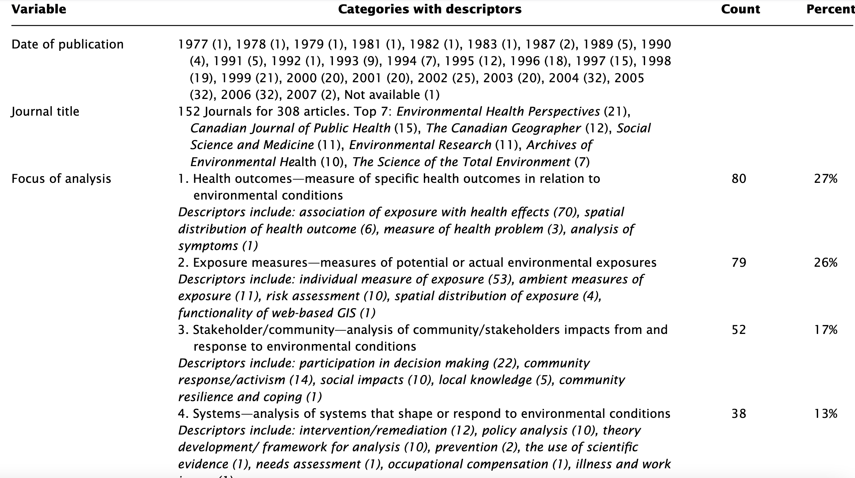
Stage 4: Extract and Synthesize Data
Masuda et al. 2008

Slide 20
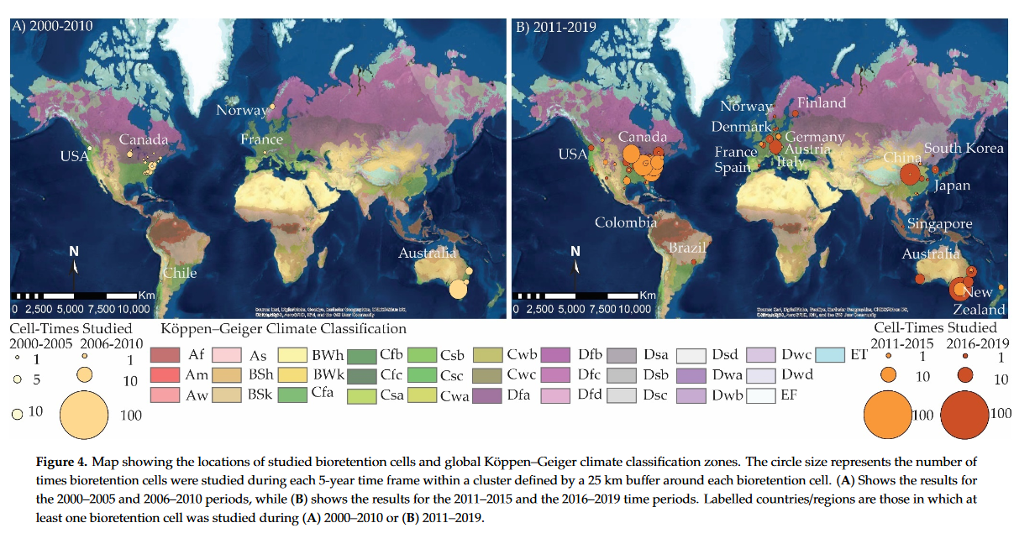
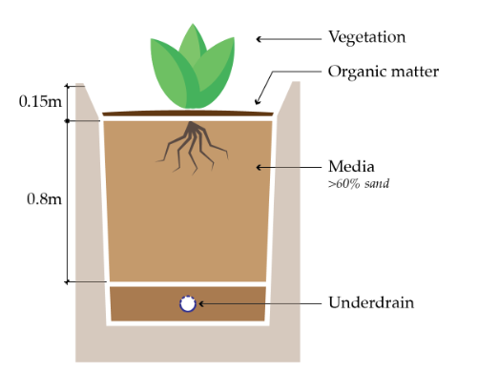
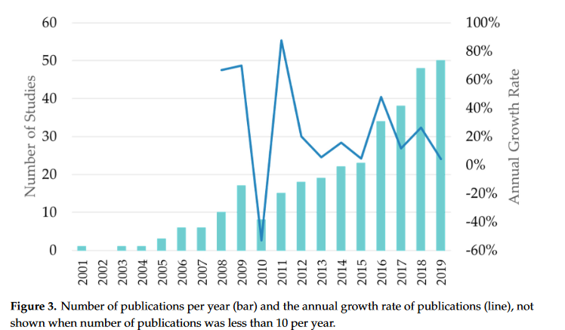
Stage 5: Chart and Report Data
Finally, once you have all that data…you get to write a paper!
Some example results from the BC scoping review:

Slide 21
Stage 6: Consultation
For added completeness, consult with members of the community (especially for scoping reviews)

Slide 22
Acknowledgements
Sylvie Spraakman (some slides)
UBC Library Guide: https://guides.library.ubc.ca/SystematicReviews/workshop#s-lg-box-16128816

Slide 23
Sources
Arksey, H., & O’Malley, L. (2005). Scoping studies: towards a methodological framework. International Journal of Social Research Methodology, 8(1), 1364–5579. https://doi.org/10.1080/1364557032000119616
Levac, D., Colquhoun, H., & O’Brien, K. K. (2010). Scoping studies: Advancing the methodology. Implementation Science, 5(1), 1–9. https://doi.org/10.1186/1748-5908-5-69
Peters MDJ, Godfrey C, McInerney P, Baldini Soares C, Khalil H, Parker D. Chapter 11: Scoping Reviews. In: Aromataris E, Munn Z (Editors). Joanna Briggs Institute Reviewer's Manual. The Joanna Briggs Institute, 2017. Available from https://reviewersmanual.joannabriggs.org/
Colquhoun, H. L., Levac, D., O’Brien, K. K., Straus, S., Tricco, A. C., Perrier, L., … Moher, D. (2014). Scoping reviews: time for clarity in definition, methods, and reporting. Journal of Clinical Epidemiology, 67(12), 1291–1294. https://doi.org/10.1016/J.JCLINEPI.2014.03.013
Moher, D., Stewart, L., & Shekelle, P. (2015). All in the Family: systematic reviews, rapid reviews, scoping reviews, realist reviews, and more. Systematic Reviews, 4(183). https://doi.org/10.1186/s13643-015-0163-7

Slide 24
Research Question Examples
﻿What are the characteristics and range of methodologies used in scoping reviews in the literature? (Pham et al. 2014)
﻿What is known from the existing literature about the effectiveness and cost-effectiveness of services to support carers of people with mental health problems? (Arksey & O’Malley 2005)
What interventions promote flexible working conditions for employees and what are the possible effects of these on health and other outcomes on employees and other relevant people?

Slide 25
Research Question Examples
O’Flaherty, J. and Phillips, C. 2015. The use of flipped classrooms in higher education: a scoping review. Journal of Internet and Higher Education 25(2015): 85-95.
The focus of our review was the exploration of key aspects of the flipped class that influence its effectiveness and contribute to an improved student flipped learning experience. To ensure that a substantial range of literature was captured relating to the topic of interest, we posed the following initial research questions to guide the search:
1. What technologies are being used to engage students in a flipped class?
2. What considerations are there pertaining to the economic and time constraints required to implement a flipped class?
3. What is known about the pedagogical acceptance by both staff and students?
4. What are the educational outcomes arising from a flipped class?
5. What is known about the conceptual framework used to design a flipped class?

Slide 26
Why conduct a scoping review?
Determine the ability to conduct a systematic review
Exercises in and of themselves
to summarize and disseminate research findings
to identify research gaps or general gaps in an area
make recommendations for the future research map a body of literature with relevance to time, location (e.g. country or context), source (e.g. peer-reviewed or grey literature), and origin (e.g. healthcare discipline or academic field)

